Slide 1
Feasibility Assessment Global Network – base case PFS (33 trials)
VINO+GEF
GEF+MET
GEM+CIS
AFA
AFA+CET
LUX-Lung 6
SWOG S1403
IFCT-1503 ACE-Lung
NCT01864681
GENOA (NCT02319577)
LUX-Lung 3
CIS+PEM
CONVINCE
ICO
INCREASE
ICO high-dose
RAM+ERL
LUX-Lung 7
ENSURE
TORCH
NCT01769066
NCT01502202
RELAY
CIS+PEM
+GEF_m
CARBO+PEM
ERL+BEV
NCT01017874
NCT02148380
CTRI/2015/08/006113
NCT02148380
JO25567 (JapicCTI-111390)
NCT01532089
NEJ026
ERL/GEF
GEF+CARBO+PEM
GEF+CARBO+PEM (Alter)
NEJ009
CTRI/2016/08/007149
NCT02148380
NEJ005
NCT01221077
GOAL
GEF+OLA
FLAURA
ARCHER 1050
LIN+ERL
CALGB 30406
NCT01469000
An 2016
NCT01897480
OSI
DAC
EMI+ERL
UMIN000013586
NCT01039948
ERL+PAC+CARBO
GEF+PEM
GEF+BEV
GEF+FIC

Slide 2
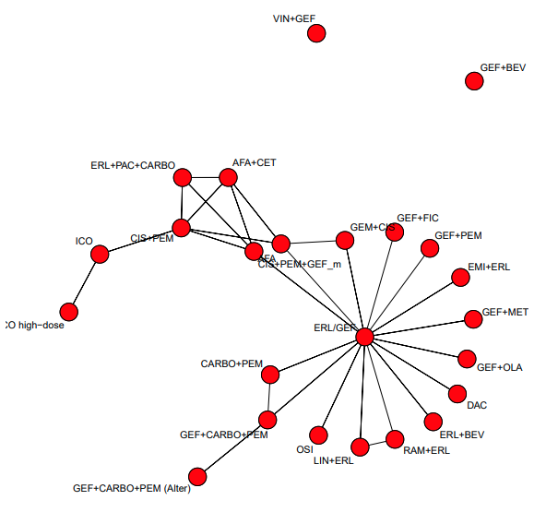
NMA Global Network – base case PFS (33 trials)

